Slide 1
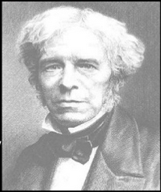
Lecture 14 Faraday’s Laws of Electromagnetic Induction

Slide 2
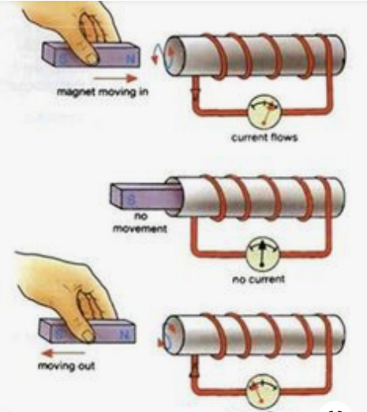
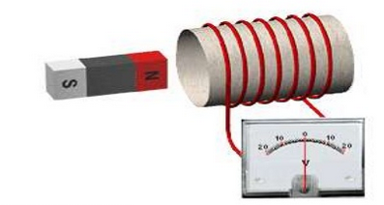
Faraday’s Experiment
Experiment set up

Slide 3
Observations
Position of magnet | Deflection in the galvanometer
Magnet at rest | No deflection
Magnet moves towards the coil | Deflection in one direction
Magnet held stationary at the same position (near to coil) | No deflection
Magnet moves away from the coil | Deflection in opposite direction
Magnet held stationary at the same position (away from the coil) | No deflection

Slide 4
Faraday’s Laws
First Law
Whenever the magnetic flux linked with the flux changes, an emf is induced in it
OR
Whenever a conductor cuts magnetic flux and emf is induced in it
Second Law
The magnitude of the induced emf is equal to the rate of change of flux linkages

Slide 5
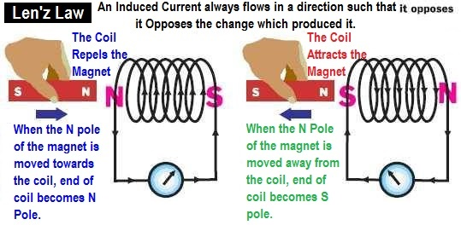
Lenz’s Law
The currents which are induced due to electromagnetic induction is in a such a direction as to oppose the cause producing them

Slide 6
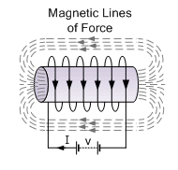
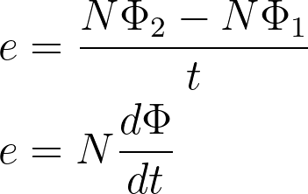
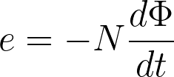
“Induced emf”
Assume:
N= number of turns in the conductor
Φ1- initial flux linked in the conductor
Φ2- final flux lined in the conductor
As per Lenz’s Law:
V

Slide 7
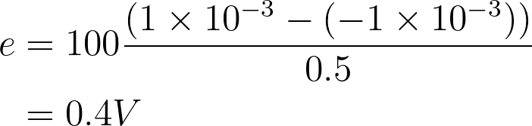
Example:
A flux of one milliweber is associated with the conductor of 100 turns gets reversed after 0.5 s. What is the value of induced emf ?
Initial flux = 1 mWb
Final flux = 1 mWb

Slide 8
Applications:
Electrical generators which produces electricity works on the principle of electromagnetic induction.
Transformer which is used to change the voltage of the alternating current works on the principle of electromagnetic induction
Working of electrical bells are based on electromagnetic induction.

Slide 9
Types of emf
Dynamically induced emf
Force on a current carrying conductor placed on a magnetic field
Statically induced emf
Self induced emf
Mutually induced emf

Slide 10
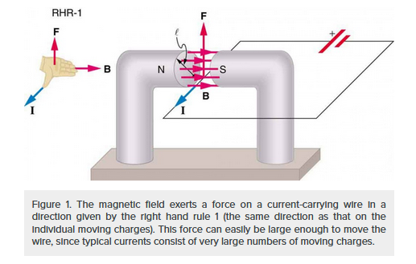
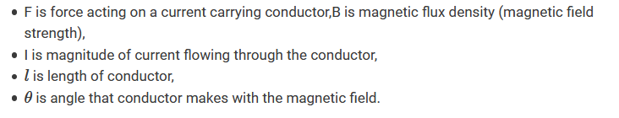
Force on a current carrying conductor placed on a magnetic field

Slide 11
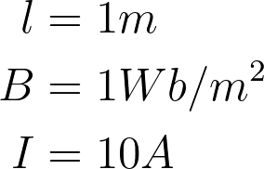

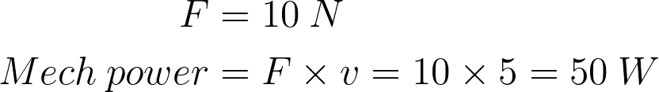
Example
A straight conductor of 1 m long and carrying a current of 10A lies perpendicular to a uniform magnetic field of 1 Wb/m^2. Calculate the mechanical force acting in it and the mechanical power required to move the conductor against the field at a speed of 5 m/s?

Slide 12
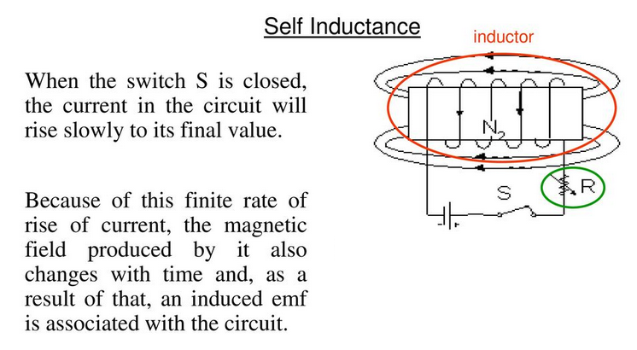
Self Inductance

Slide 13
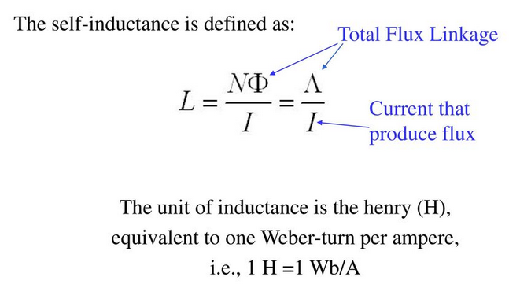
This phenomenon, the appearance of an induced emf in associated with the changes in its own magnetic field is known as self-induction
This property of the coil is self inductance

Slide 14
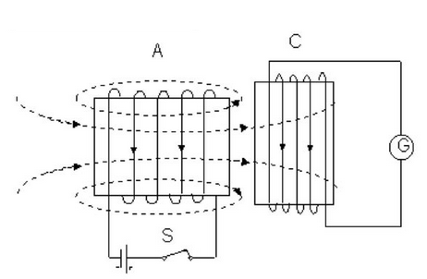
Mutual Inductance
A change of current in one coil is accomplished by
the change of flux linked with the other coil
that result the emf induced in the later.
The two coils are said to have mutual inductance
Mutual inductance is an ability of one current loop to induce
an emf in the adjacent loop when the current in the first loop changes.
It is measured by the parameter called mutual inductance. Unit is Henry

Slide 15
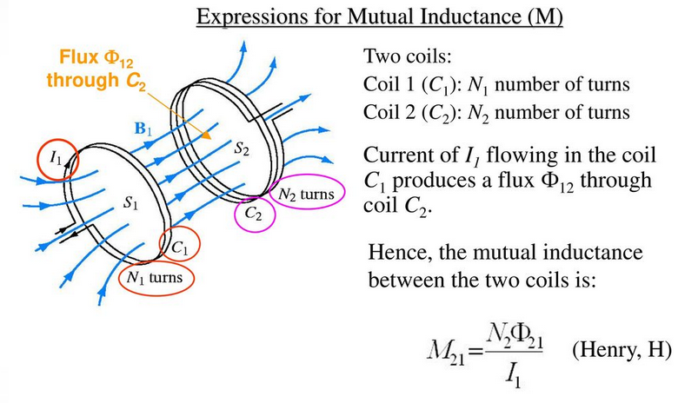
Expressions for Mutual Inductance

Slide 16
Thank You

